Slide 1

Report Analytics & Dashboard
Analytics for Stake-Holders

Slide 2

Group 3
Pari Lukka
Ritika Biswas
Harshad Narayana
Aditya Chavan
Suyanka Naiknaware
Kartik Sonawane
Siddhi Deshmane

Slide 3
Summary
Overall Performance Metrics:
Cross Sell Placed Achievement: 64.94%
Cross Sell Invoice Achievement: 14.21%
New Placed Achievement: 17.95%
New Invoice Achievement: 2.90%
Renewal Placed Achievement: 150.23%
Renewal Invoice Achievement: 66.92%
Stages by Revenue:
Negotiate: 89,000
Propose Solution: 60,000
Qualify Opportunity: 591,500
Yearly Meeting Count:
2019: 5 meetings
2020: 51 meetings
Achievement Metrics:
New Opportunities:
Achieved: 3,531,629
Invoice: 569,815
Target: 19,673,795
Cross Sell Opportunities:
Achieved: 1,504,155
Invoice: 283,842
Target: 20,063,111
Renewal Opportunities:
Achieved: 1,857,271
Invoice: 824,310
Target: 13,199,465

Slide 4
Summary
Account Executive Performance:
Number of Invoices by Account Executive:
Top performers:
Abhishek Sharma (7),
Aniruddh Rawal (5),
Avinash Kumar (5),
Number of Meetings by Account Executive:
Top performers: Vijaya (50), Shakti Agarwal (45), Prashant Singh (40), Gautam Kumar (30), and others.
Opportunity Metrics:
Total Open Opportunities: 44
Opportunities by Revenue (Top 4):
Firm: 500,000
XL-Group Medilife: 400,000
DB-Mega Policy: 300,000
GVP GMC: 200,000
Opportunity Product Distribution:
Employee Benefits: 31%
Engineering: 27%
Fire: 14%
Liability: 10%
Marine: 4%
Miscellaneous: 13%
Terrorism: 1%

Slide 5
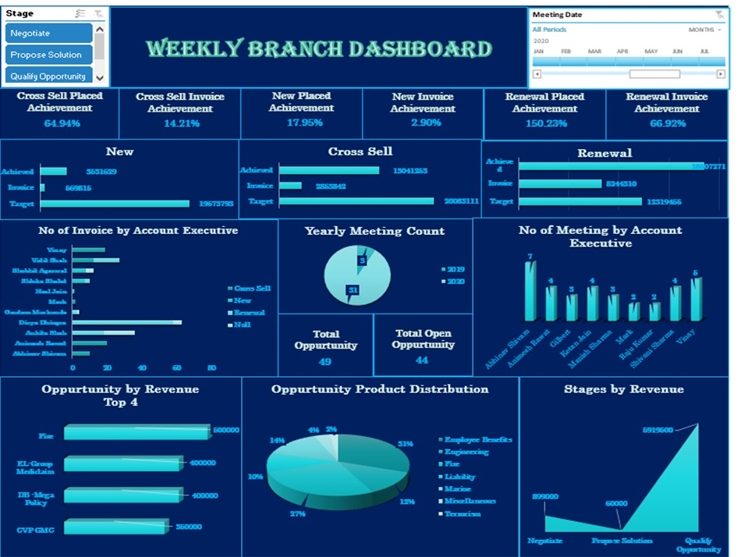
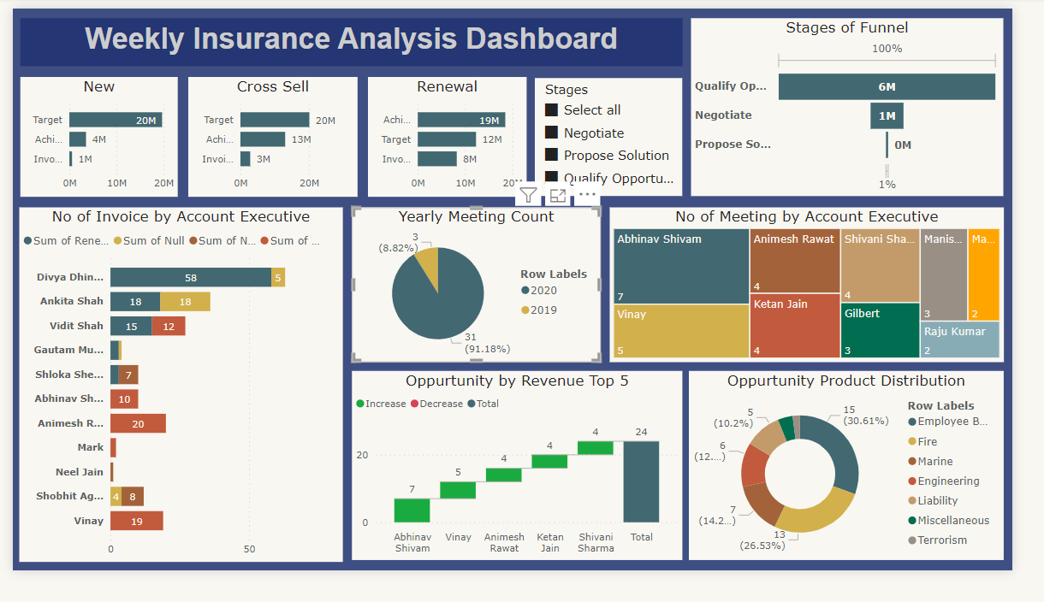
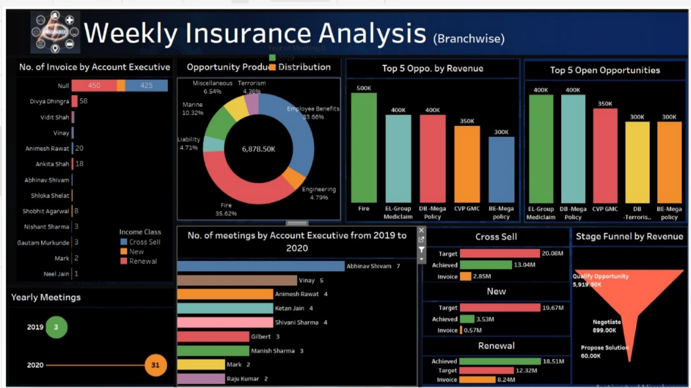
Observations
The dashboard highlights several issues: low invoice achievements for new (2.90%) and cross-sell (14.21%) opportunities, indicating poor conversion rates. There is a significant gap between achieved and targeted values in these segments. Despite a high number of meetings, this does not translate into higher invoice achievements. Revenue is concentrated in the "Qualify Opportunity" stage, suggesting a bottleneck in progressing opportunities. Additionally, invoice distribution among account executives is uneven, indicating potential inefficiencies or workload imbalances.

Slide 6
Key Insights:
Renewal opportunities have significantly higher achievement and invoice rates compared to new and cross-sell opportunities.
There is a substantial increase in the number of meetings from 2019 to 2020.
The top revenue-generating opportunities are dominated by firms and XL-Group Medilife.
Employee benefits and engineering constitute the largest portions of the opportunity product distribution.
The majority of revenue is in the "Qualify Opportunity" stage, highlighting a significant pipeline potential.
Recommendations:
Focus on improving the achievement and invoice rates for new and cross-sell opportunities.
Leverage the success in renewal opportunities to replicate strategies in other areas.
Increase efforts in the proposal solution stage to balance the distribution of revenue across different stages.
Continue the trend of increasing meetings and engagements with account executives to drive performance.

Slide 7
Excel dashboard

Slide 8
Tableau dashboard

Slide 9
Power bi dashboard

Slide 10
Thank you
www.proseware.com

